Slide 1
Oil Field Life Cycle
Presenter: Tam Tran

Slide 2
Objectives
Helps testers visualize Petroleum Industrial Picture.
Testers can know where they are and what are they doing in each application.

Slide 3
Mapping/Prospect Generation
Discovery
Reservoir Delineation
Primary Production/Facilities
Enhanced Recovery
Abandon
Acquire/Divest
Oil Field
Life Cycle

Slide 4
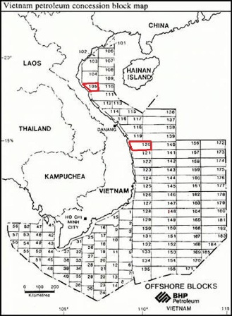
Acquire/Divest
It all starts here!

Slide 5
Mapping/Prospect Generation
Discovery
Reservoir Delineation
Primary Production/Facilities
Enhanced Recovery
Abandon
Acquire/Divest
Oil Field
Life Cycle

Slide 6
Geological and Geophysical Technologies
GMI•Imager™
LogEdit™
StratWorks®
StratWorks® 3D
Z-MAP Plus™
DecisionSpace
Depth Conversion
Well Seismic Fusion™
SeisWorks® 2D
SeisWorks® 3D
GeoProbe® ….

Slide 7
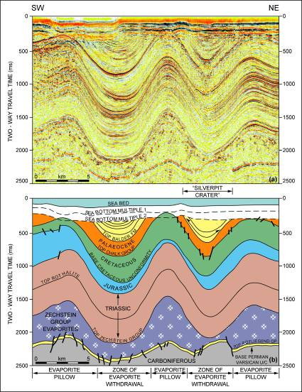
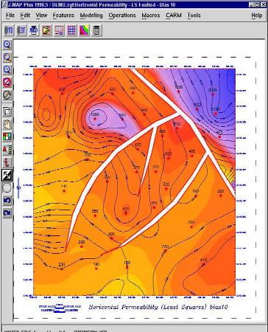
Mapping Reconnaissance
The first thing we do is to evaluate existing data and if necessary acquire new data for the prospect area.

Slide 8
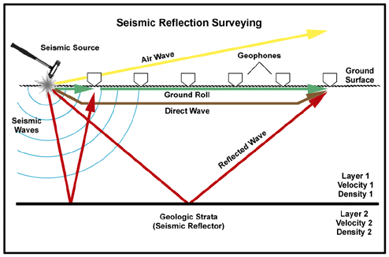
Seismic Reflection Surveying

Slide 9
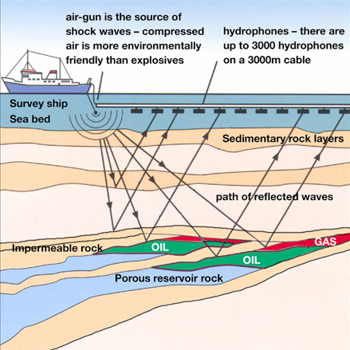

Slide 10
Prospect Generation: The Old Way

Slide 11
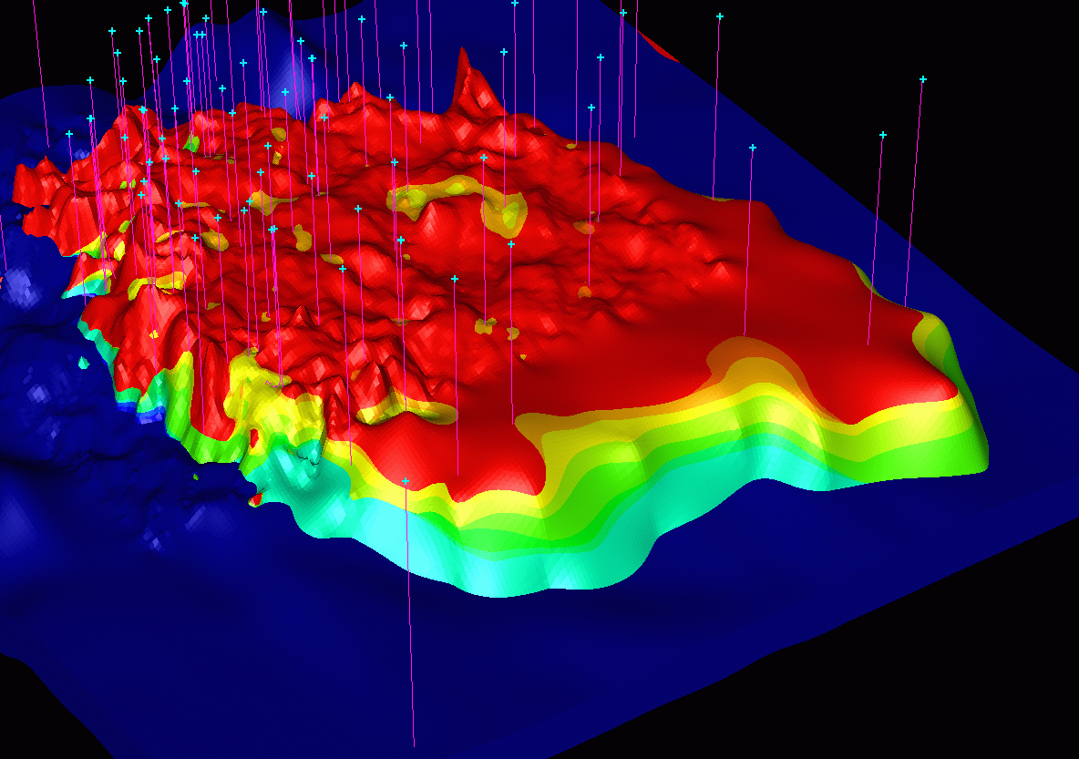
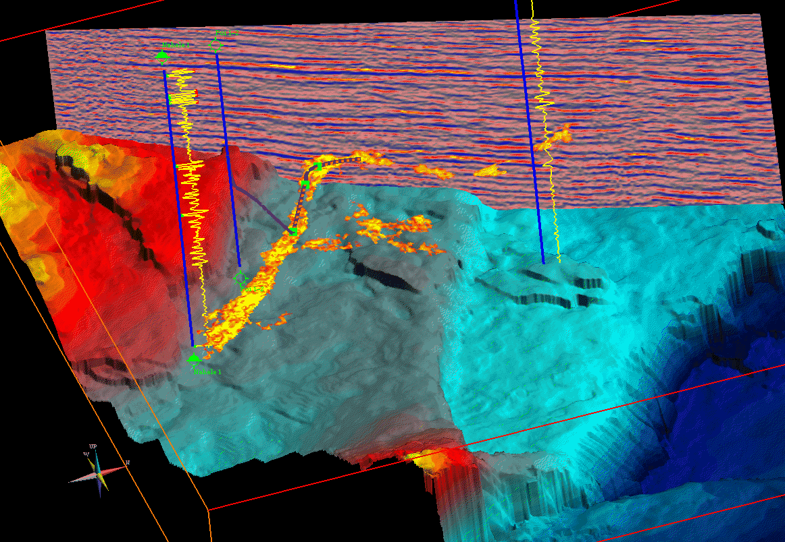
Prospect Generation: The New Way

Slide 12
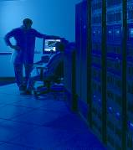
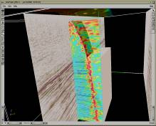
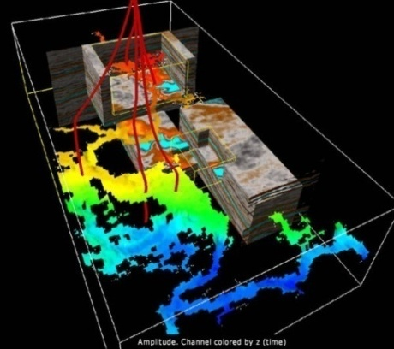
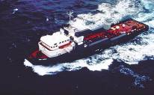
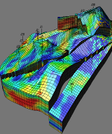
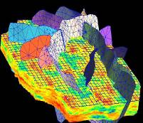
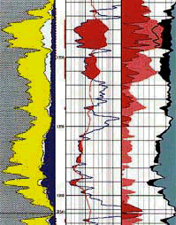
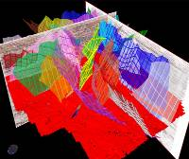
Prospect Generation: The New Way
Data Acquisition
Data
Management
Interpretive
Processing
Visual
Interpretation
1
2
3
4
8
7
6
5
Property
Modeling
Rock/Fluid
Estimation
Framework
Construction
Simulation

Slide 13
Mapping/Prospect Generation
Discovery
Reservoir Delineation
Primary Production/Facilities
Enhanced Recovery
Abandon
Acquire/Divest
Oil Field
Life Cycle

Slide 14
Drilling and Completions
Well Planning
Geo-Pressure Prediction
Tubular Design & Analysis
CasingSeat™
StressCheck™
COMPASS™
WELLCAT™
Well Costing
DrillModel™
Wellbore Design
WELLPLAN™ BHA Drillahead
WELLPLAN™ Cementing-OptiCem
WELLPLAN™ Critical Speed Analysis
WELLPLAN™ Hydraulics
WELLPLAN™ StuckPipe
WELLPLAN™ Suite
WELLPLAN™ Surge
WELLPLAN™ Torque and Drag
WELLPLAN™ WellControl
Well Data Management
Data Analyzer™
OpenWells®
OpenWire®
PROFILE™
Real-Time View
Notes:
Well Design, Planning, and Placement For Optimized Production
Integration with subsurface G&G data through the OpenWorks database enables concurrent visualization of engineering data and the earth model which can help generate more accurate targets and position wellbores more precisely. Engineers, geoscientist and contractors can all share and visualize information as a team, evaluate alternatives and collaborate on designing the best solutions. This approach ultimately improves reservoir yields - the biggest payoff. Landmark’s drilling and completions solutions deliver all the tools you need to plan, execute and analyze all well types - from onshore operations to complex deepwater projects.

Slide 15
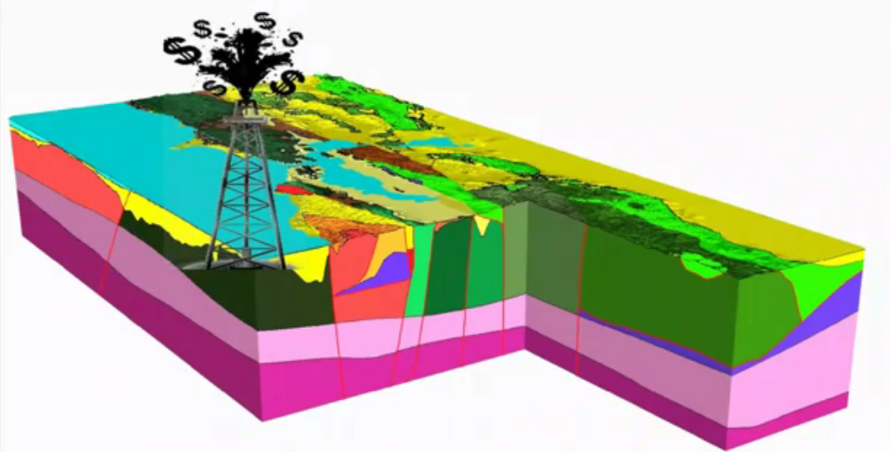
Discovery
… a shot in the dark?

Slide 16
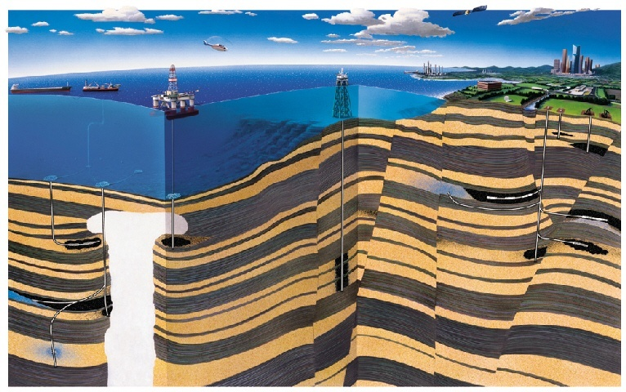
Reservoir Development

Slide 17
Mapping/Prospect Generation
Discovery
Reservoir Delineation
Primary Production/Facilities
Enhanced Recovery
Abandon
Acquire/Divest
Oil Field
Life Cycle

Slide 18
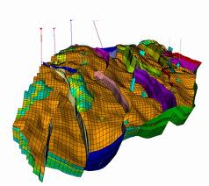
Reservoir Delineation
Defining the reservoir:
How big is it?
How much oil or gas?
How easily can it be recovered?
How much is it worth?
Notes:
Once we have identified a possibly petroleum reservoir, using seismic interpretation of our “soundings” – we need to test our hypothesis by drilling “wells” into the earth. In effect, we are attempting to insert our “straws” into the identified “bumps” in the subsurface. Well planning is generally performed within the visual context of our interpretation environment.

Slide 19
Reservoir Management
Decision Management
DMS™ (Decision Management System)
FieldPlan®
Reservoir Simulation
Nexus®
PowerGrid™
Knoesis…

Slide 20
Mapping/Prospect Generation
Discovery
Reservoir Delineation
Primary Production/Facilities
Enhanced Recovery
Abandon
Acquire/Divest
Oil Field
Life Cycle

Slide 21
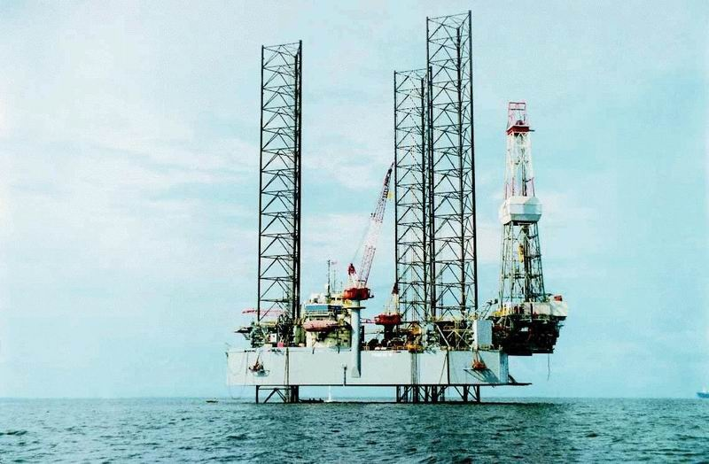
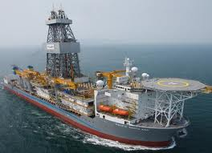
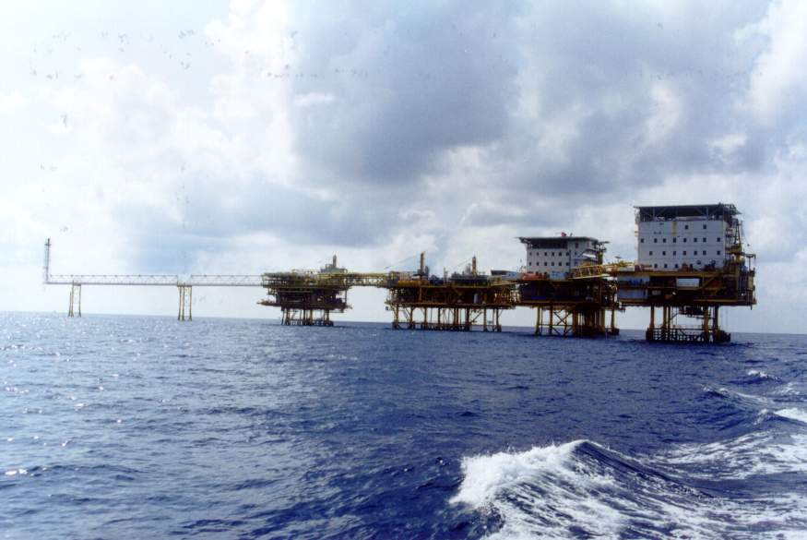
Facilities
Planning for drilling & production facilities
Facilities construction

Slide 22
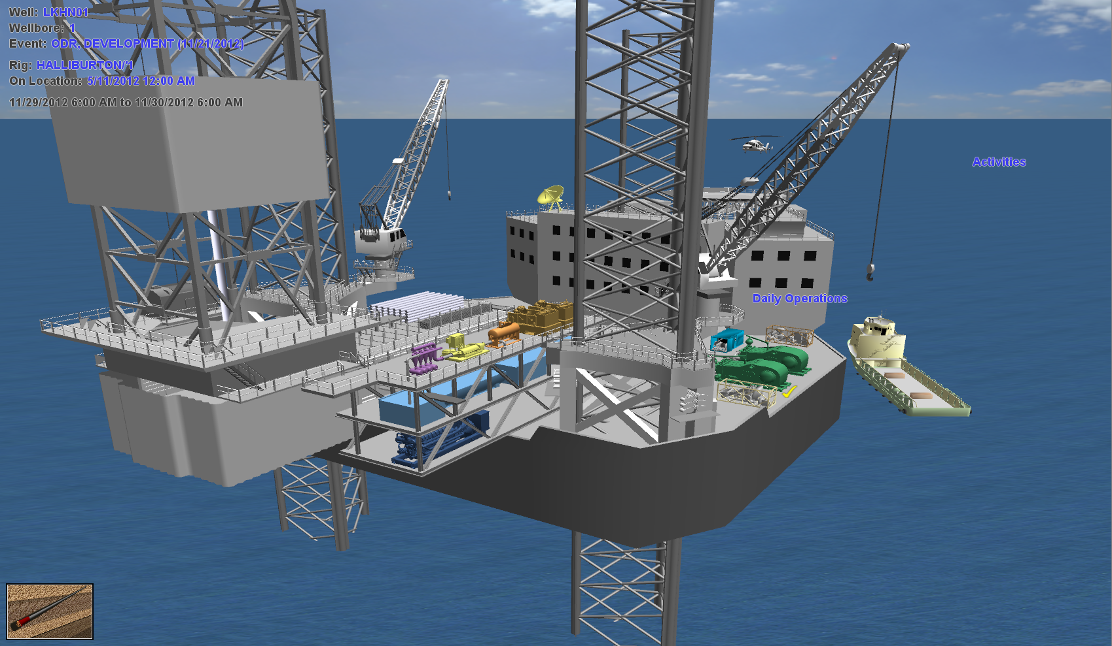
Facilities

Slide 23
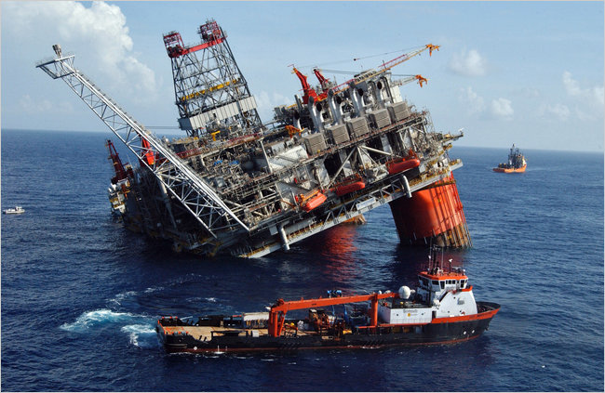
The Need for Real-Time Operations
BP’s $1 Billion Thunderhorse platform damaged by Hurricane Dennis

Slide 24
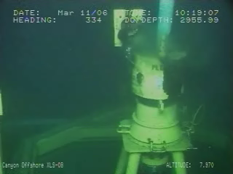
The Ned for Real-Time Operations
This could be tough on your well …

Slide 25
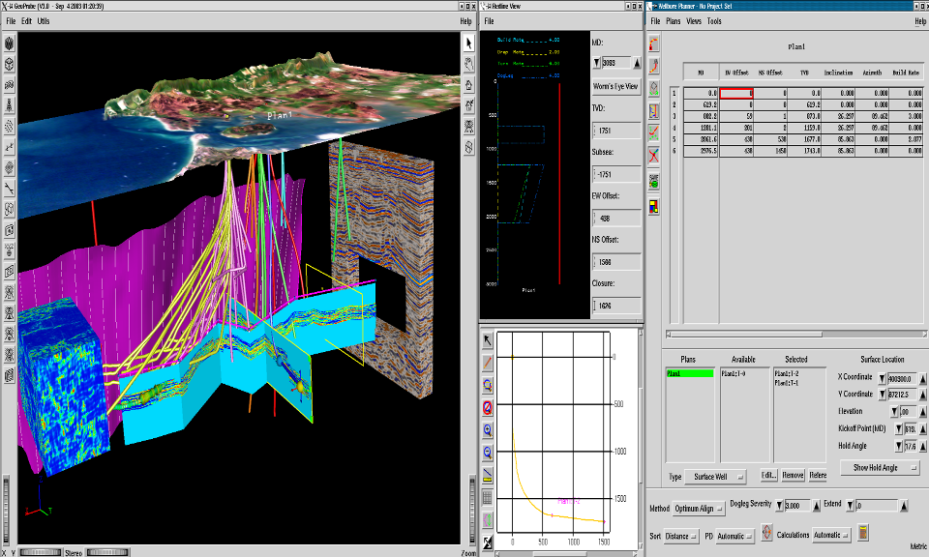
Primary Production

Slide 26
Mapping/Prospect Generation
Discovery
Reservoir Delineation
Primary Production/Facilities
Enhanced Recovery
Abandon
Acquire/Divest
Oil Field
Life Cycle

Slide 27
Production Optimization
DecisionSpace® for Production™
ARIES™
ARIES™ Portfolio
ARIES™ RMS
Knoesis…
Engineer's Desktop
Desktop Navigator™
OpenWire® Production™
Engineering
Field Data Capture…

Slide 28
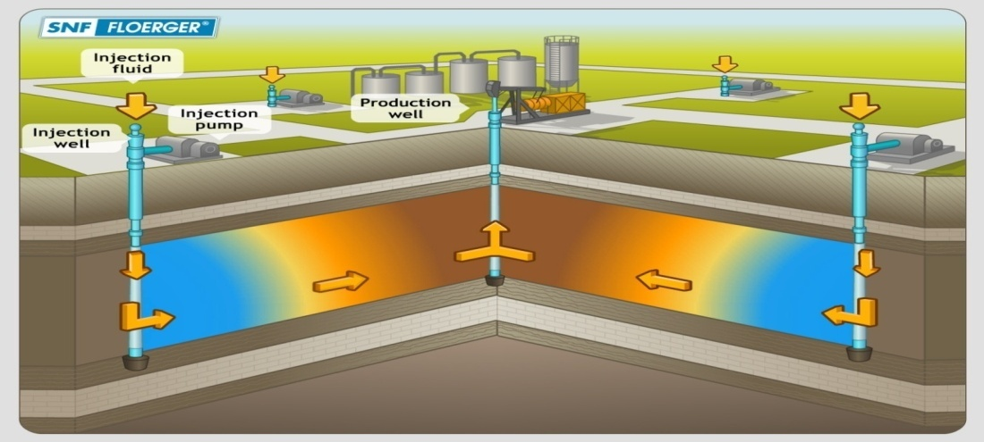
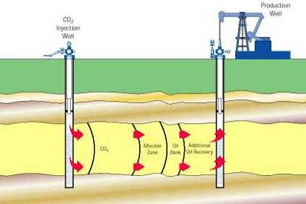
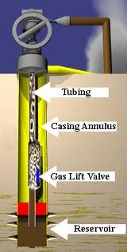
Enhanced Recovery
New oil from old reservoirs.
How to increase EOR?
Keep doing this as long as economically viable…

Slide 29
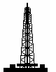

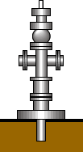
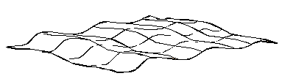
Components of Field Operations (On & Off Shore Production)
Surface Facilities Work
Production Operations
Oil & Gas to Market Delivery Contracts
Oil Treatment
Oil Delivery
Gathering & Separation
Gas Treatment
Gas Delivery
Drilling and
Completion
Water Handling
Injection
Sub-Surface Well Work
Reservoir
Management

Slide 30
Mapping/Prospect Generation
Discovery
Reservoir Delineation
Primary Production/Facilities
Enhanced Recovery
Abandon
Acquire/Divest
Oil Field
Life Cycle

Slide 31
Abandon
Collect the materials…
Isolate the wells to environment…

Slide 32
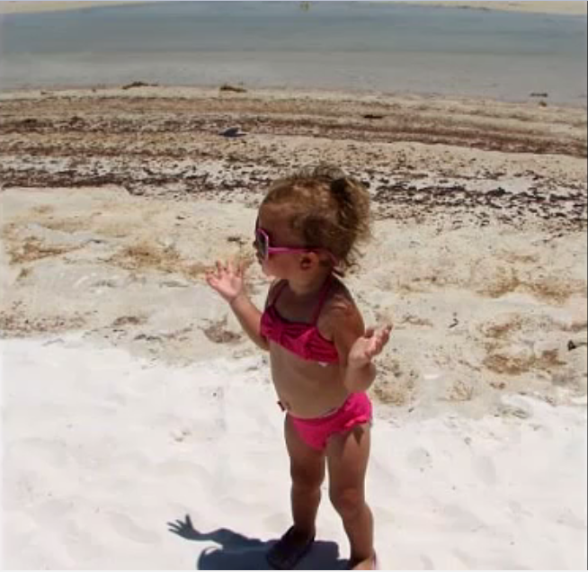
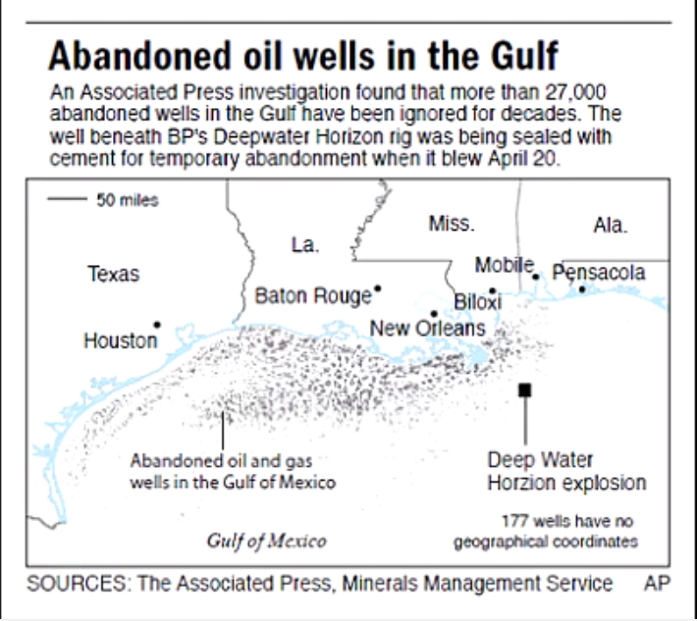

What kind of world????
Most of the oil and gas companies often ignore the abandonment…

Slide 33
Thanks for your attention
Q&A

